Slide 1








Intelligence
Are the things shown below, Intelligent?

Slide 2
Intelligence
Covey meaning without thinking more than a second.
Associated with living being.
Characteristic of species not only human but also animals.

Slide 3
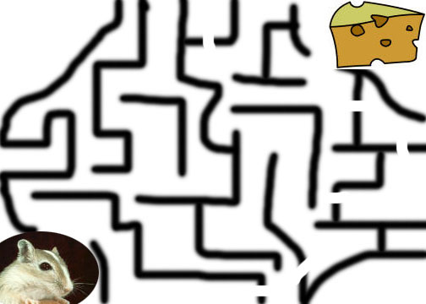
Ex-1: Searching a path …
Different mice might follow different paths based to their intelligence
In other words: The problem can be solved in many ways
Ability to solve problems demonstrates Intelligence

Slide 4
Ex-2: Next number in the sequence …
Consider the following sequence …
1,3,7,13,21,__
  What is the next number ?
Key: Adding the next EVEN number …
1+2 = 3; 3+4 = 7; 7+6 = 13; 13+8 =21; 21+10 = 31
1,3,7,13,21,31
Ability to solve problems demonstrates Intelligence

Slide 5
Ability to Plan and schedule
Timetable scheduling assignment

Slide 6
Memorize and Process Information
Example of Doctor’s prescription
Typhoid pre-prediction by medical history
Memorize as per studied in medical degree
Suggest by previous experience of a patient
Take general test like fever, weight, BP etc. (process information)

Slide 7
Ambiguity
Example of Tall.
Considered as Tall, may be Tall, Perhaps Tall (Ambiguous information)
It’s easy to solve unambiguous problems like (set of days of week, prime no etc)
Intelligence is to take decisions/process information on the basis of fuzzy knowledge.

Slide 8
Understanding and Perception
If I mute my voice how would you consider what type of discussion is it?
This understanding/observation of environment and perception/mental picture is based on intelligence.

Slide 9
Recognition and Learning
Face recognition
Things retain in our mind if we see them again and again.
Pattern is build in our mind.
We are then able to recognize/identify a known person any where.

Slide 10
So, Let’s Summarize…
Ability to solve problems
Ability to plan and schedule
Ability to memorize and process information
Ability to answer fuzzy questions
Ability to understand
Ability to perceive
Ability to recognize
Ability to learn
And many more …
Food for thought: Can only humans beings and animals possess these qualities?

Slide 11
What if?
A machine searches through a mesh and finds a path?
A machine solves problems like the next number in the sequence?
A machine develops plans?
A machine diagnoses and prescribes?
A machine answers ambiguous questions?
A machine recognizes fingerprints?
A machine understands?
A machine perceives?
A machine does MANY MORE SUCH THINGS …
A machine behaves as HUMANS do? HUMANOID!!!

Slide 12
Systems that THINK Like Humans
“[The automation of] activities that we associate with human thinking, activities such as decision making, problem solving, learning …” (Bellman, 1978)

Slide 13
Systems that THINK Like Humans
“The exciting new effort to make computers think … machines with minds, in the full and literal sense” (Haugeland, 1985)

Slide 14
Systems that THINK Like Humans
“The study of computation that make it possible to perceive, reason and act” (Winston 1992)

Slide 15
Systems that THINK Like Humans
“The study of mental faculties through the use of computational models” (Charniak and McDermott)

Slide 16
Systems that ACT Like Humans
“The art of creating machines that perform functions that require intelligence when performed by people” (Kurzweil 1990)

Slide 17
Systems that ACT Like Humans
“The branch of computer science that is concerned with the automation of intelligent behavior” (Luger and Stubblefield, 1993)

Slide 18
History of AI
The field of AI research was founded at a conference on the campus of Dartmouth College in1956. The attendees became the leaders of AI research for many decades. They and their students wrote programs that were, to most people, simply astonishing: Computers were solving word problems in algebra, proving logical theorems and speaking English.

Slide 19
History of AI
•By the middle of the 1960s, research in the U.S. was heavily funded by the Department of Defense and laboratories had been established around the world.
AI's founders were profoundly optimistic about the future of the new field: Herbert Simon predicted that "machines will be capable, within twenty years, of doing any work a man can do“.

Slide 20
History of AI
They had failed to recognize the difficulty of some of the problems they faced. In 1974, in response to the criticism of Sir James and ongoing pressure from the US Congress to fund more productive projects, both the U.S. and British governments cut off all undirected exploratory research in AI. The next few years, when funding for projects was hard to find, would later be called the "AI winter".

Slide 21
In the early 1980s, AI research was revived by the commercial success of expert systems , a form of AI program that simulated the knowledge and analytical skills of one or more human experts. By 1985 the market for AI had reached over a billion dollars.
At the same time, Japan's fifth generation computer project inspired the U.S and British governments to restore funding for academic research in the field. However, beginning with the collapse of the Lisp Machine market in 1987, AI once again fell into disrepute, and a second, longer lasting AI winter began.

Slide 22
In the 1990s and early 21st century, AI achieved its greatest successes. Artificial intelligence is used for supply chain management, data mining, medical diagnosis and many other areas throughout the technology industry.
The success was due to several factors:
•the increasing computational power of computers,
•a greater emphasis on solving specific sub problems ,
•the creation of new ties between AI and other fields working on similar problems

Slide 23
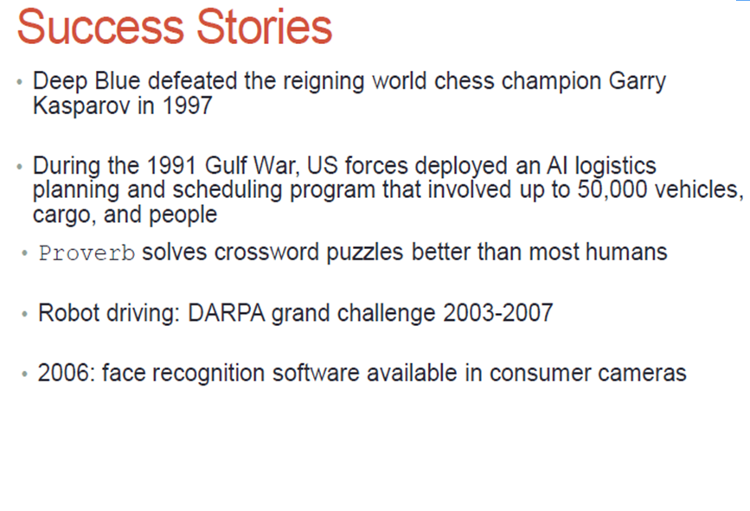

Slide 24
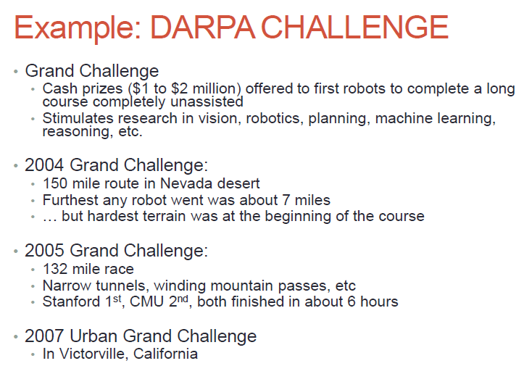

Slide 25
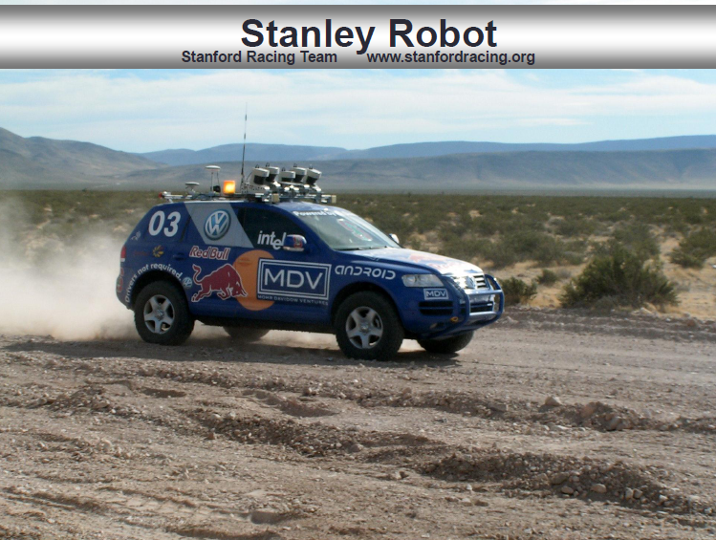

Slide 26


Slide 27
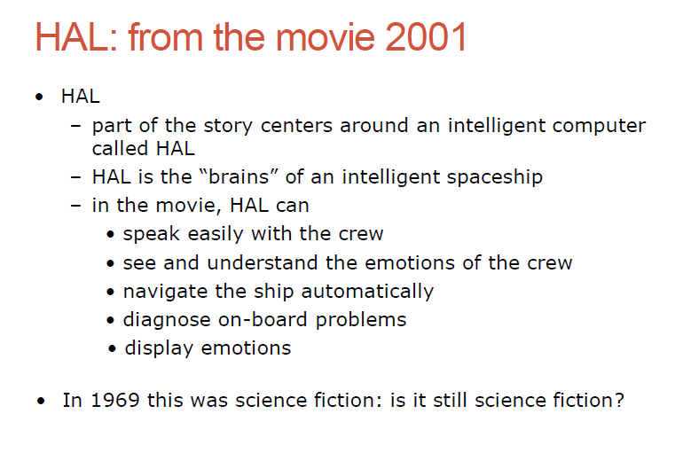

Slide 28
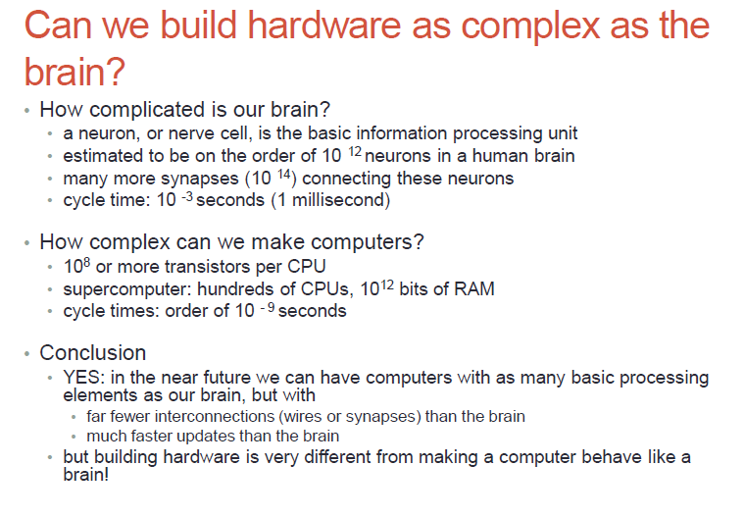

Slide 29
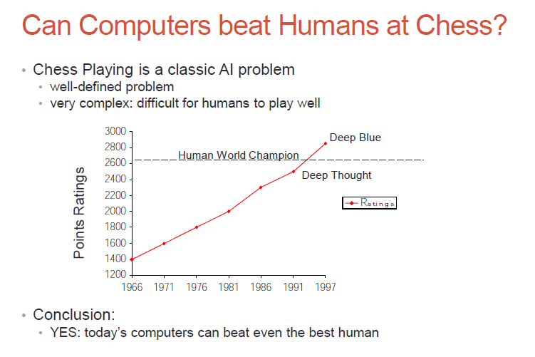

Slide 30
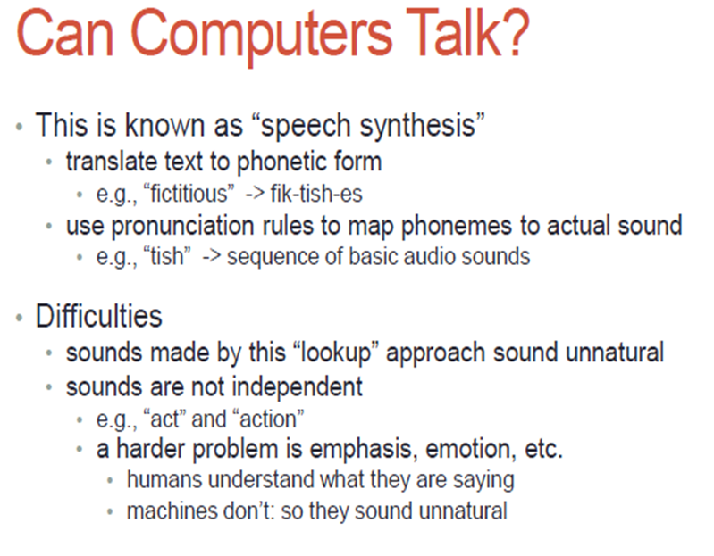

Slide 31
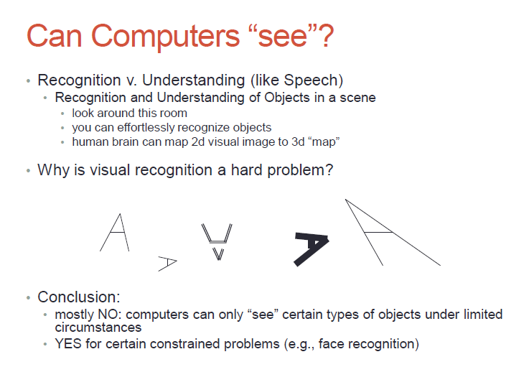

Slide 32
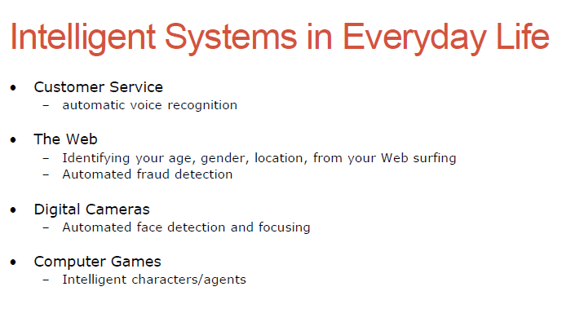

Slide 33
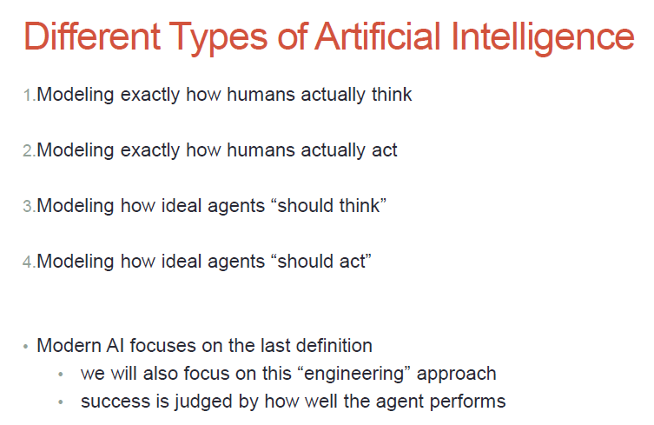

Slide 34
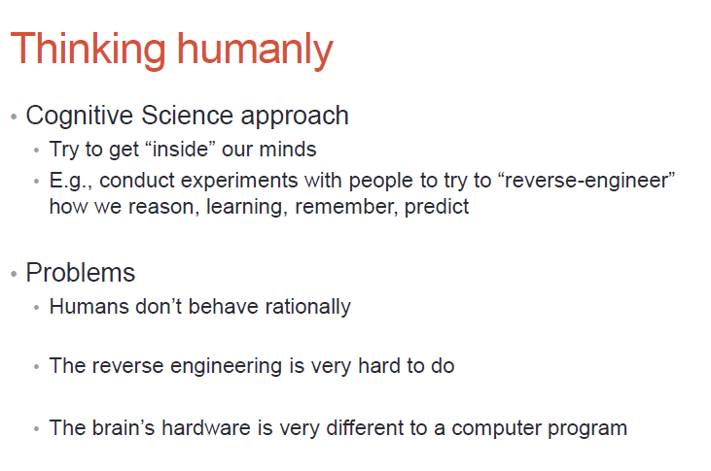

Slide 35
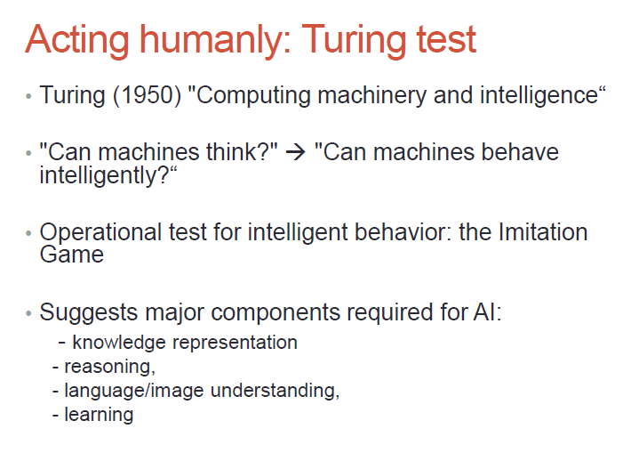

Slide 36
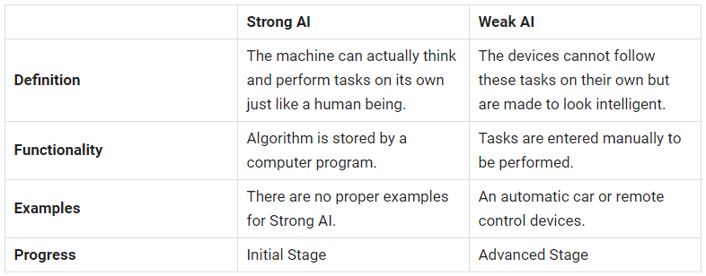
Strong AI vs Week AI

Slide 37
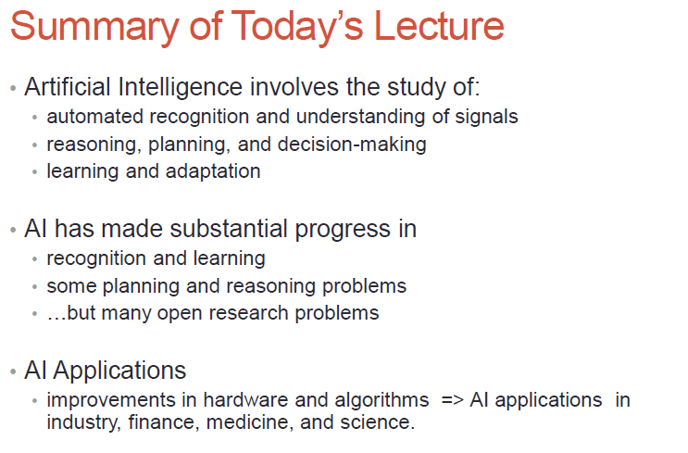

Slide 38
Introductory Quiz
Human resource management
Agriculture
Banking
healthcare

